Slide 1
Unveiling the Coding Horizons: A Comprehensive Analysis of Global Developer Trends and Career Trajectories
Team:
Sai Gowtham Dasappa Ravindra
Abhishict Pamula
Rohith Reddy Peddi
Sai Srinivasa Subrahmanyam Puranam
Bhuvanendra Putchala

Slide 2


OVERVIEW
This study focuses on how coding skills, career choices, & passions paint a complex picture of developer pay across industries and nations.
It aims to find hidden patterns in the data, we make use of statistical techniques like hypothesis testing and the comprehensive 2023 Stack Overflow Developer Survey.
Survey Data
Developer Trends
Career Analysis
Data-Driven Exploration

Slide 3
About Data
Data has been taken from the Stack Overflow’s 2023 Developer Survey.
Key columns selected for the analysis include age, employment type, coding activities, education level, coding experience, developer type, country, total compensation, and preferences in programming languages.
Several Pre-processing steps were done to address missing values and eliminate illogical entries, enhancing the reliability of the analysis.

Slide 4

Fundamental Point of this Analysis
How do various factors including coding experience, language preferences and career choices shape the financial landscape for Developers Worldwide?

Slide 5
Agenda
Data Preprocessing
Removing Missing & Outliers
Restructuring Categorical Columns
Hypothesis Testing Chi Square Test
Z Test, Proportions Z Test
Selecting Columns for Identifying Developer Career Trajectories
Exploratory Data Analysis
Box Plots Cluster Plots Correlation Analysis
Inference of Results
Understanding EDA Results and Drawing Conclusions from Hypothesis Tests

Slide 6

Data Pre-Processing
Focused on key features like Age, Employment, CodingActivities, EdLevel, YearsCode, DevType, Country, LanguageHaveWorkedWith, LanguageWantToWorkWith, Industry, WorkExp, and ConvertedCompYearly for relevant insights.
Ensured data integrity by removing any missing values.
Categorized "Employment" types for better understanding of various working arrangements.
Streamlined "YearsCode" experiences, converting less than a year to 1 and over 50 years to 51, keeping things clear.
Organized "Years of Coding Experience" and "Work Experience" into bins for clearer analysis.
Eliminated outliers – those earning over $225,000 – from salary data to maintain fair analysis.

Slide 7
Visualizations from Exploratory Data Analysis

Slide 8
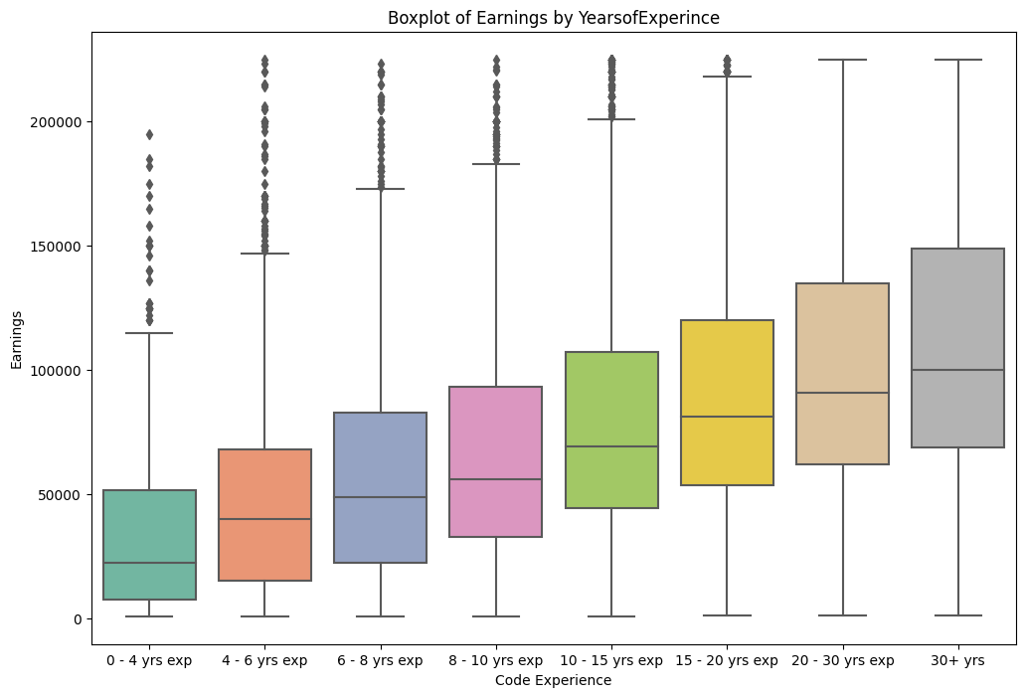
Decoding Career Trajectories
The Boxplot of Earnings Vs Years of Coding Experience revealed a compelling positive correlation between years of coding experience and earnings. This nuanced relationship signifies a proportional increase in income with accumulating coding expertise. This insight provides valuable context for developers navigating their career paths.

Slide 9
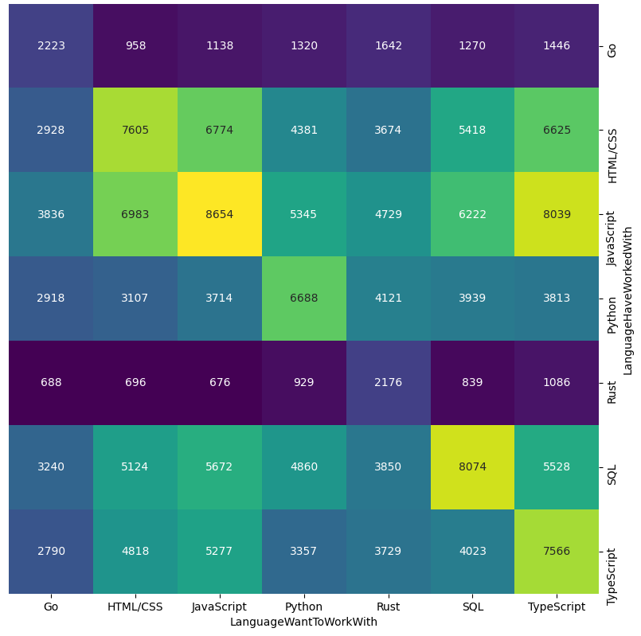
Mapping Language Preferences
Language Worked With | Languages Want to Work With
JavaScript | TypeScript, Rust and Go
HTML/CSS | Rust, SQL, Typescript, and JavaScript
Python | Rust, JavaScript, TypeScript and Go
SQL | JavaScript, HTML/CSS, Rust and Python

Slide 10
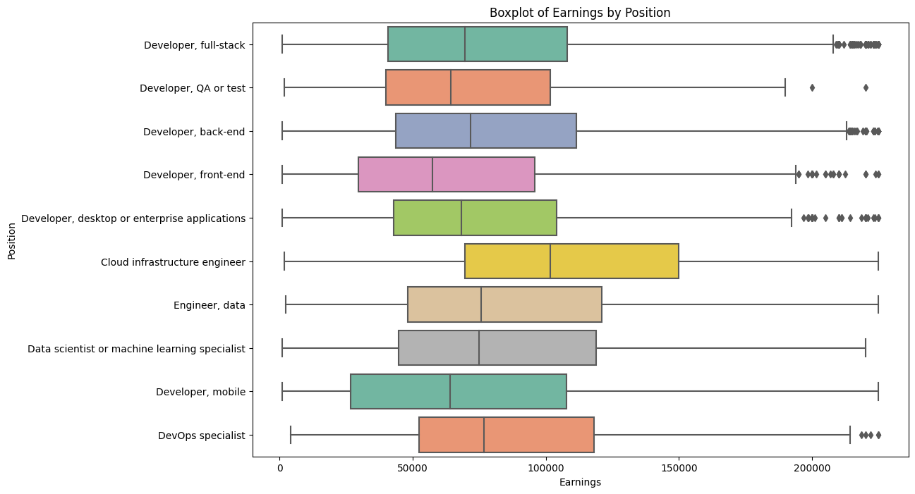
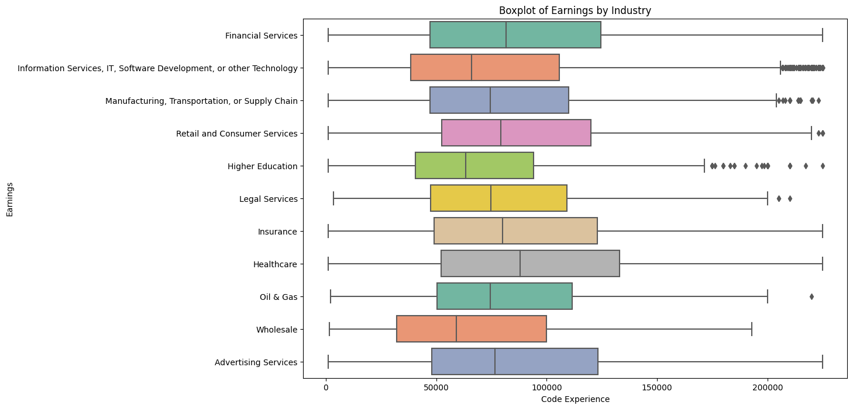
Profiling Developer Roles
The Boxplot of Developer Type/Industry & Earnings provided a comprehensive profile of developers' roles and industries, revealing that cloud, back end, full stack, and machine learning engineers often command higher median salaries. Industries such as healthcare, financial services, and insurance emerged as high-earning domains, contributing to discussions on income variations.

Slide 11
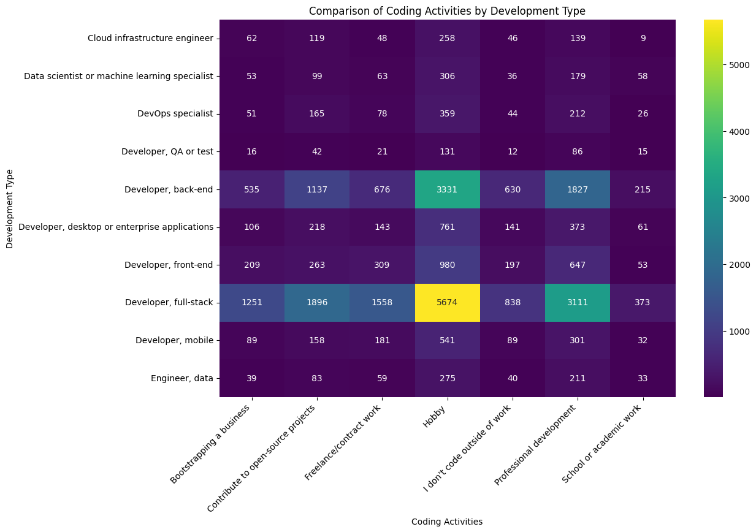
Beyond Professional Work
The Heatmap of Developer Type and Coding Activities delved into the multifaceted engagements of developers. Notably, full-stack and backend developers emerged as avid enthusiasts, engaging in coding as a major hobby, freelancing, and contributing to open source. This insight broadens the understanding of developers' diverse interests beyond their professional roles.

Slide 12
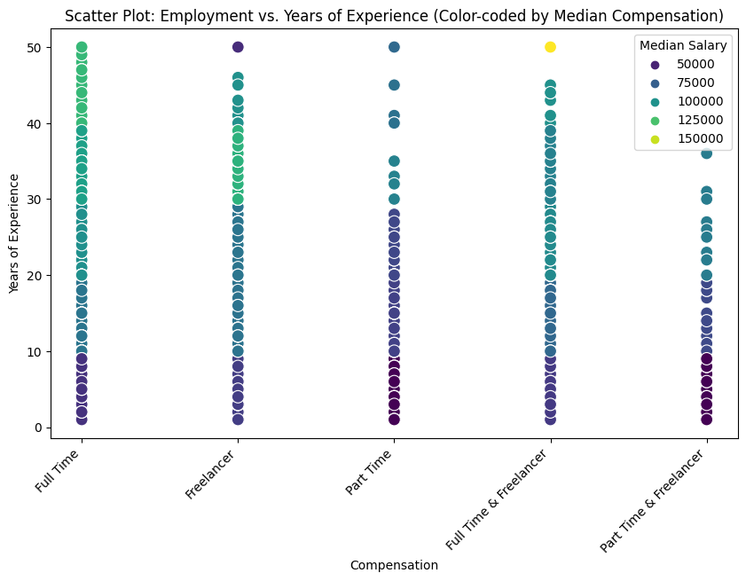
Navigating Career Paths
The plot exploring employment, experience, and median pay reveals how job choices impact earnings over time. Full-time workers see a steady salary increase with experience. Those juggling both full-time and freelancing roles follow a similar trend. However, freelancers earn more in the early career stages. These findings provide useful insights for developers and employers, highlighting the dynamics between work choices, career growth, and pay.

Slide 13
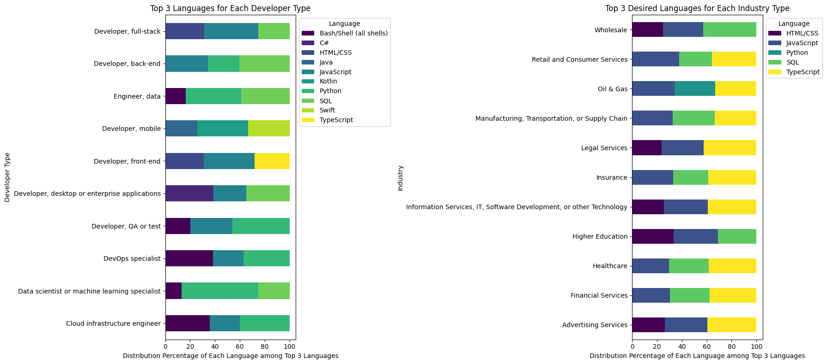
Favorite Tech Stack Across Developers & Industries
This examination highlighted the languages favored by developers in diverse roles and industries. Key discoveries reveal the widespread use of SQL, Python, and Bash among all developers. However, specific roles such as full-stack and back-end developers show a preference for languages like TypeScript, HTML/CSS, and JavaScript.

Slide 14
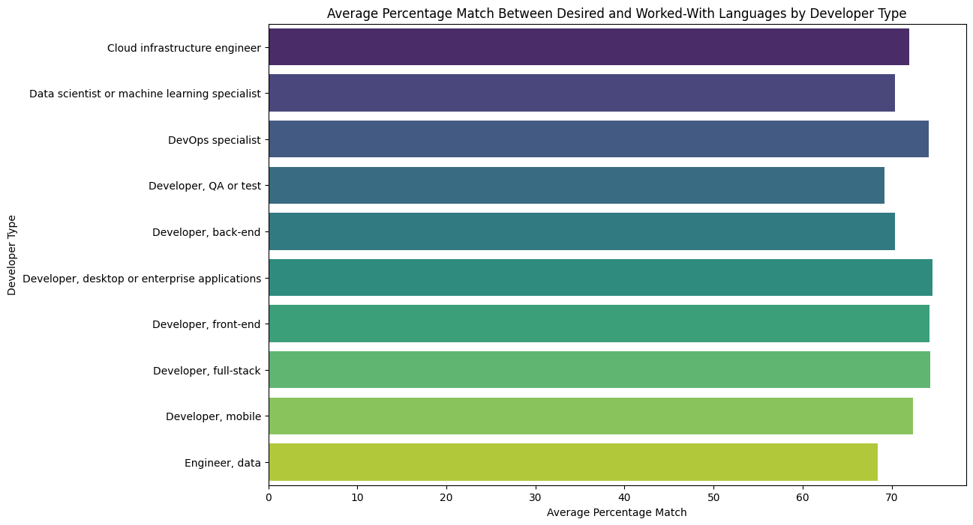
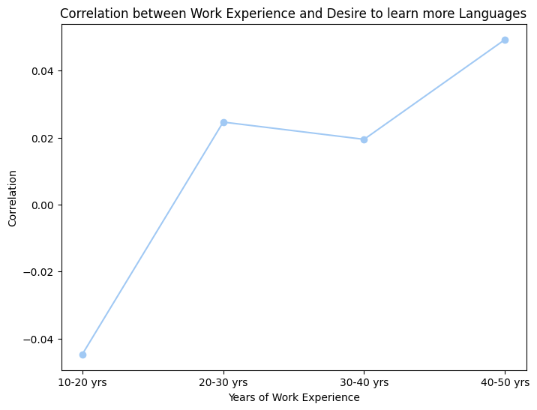
Language Adapting Patterns Across Ages
Delving into the dynamics of language acquisition, the analysis explored the correlation between developers' years of experience and their desires to learn new languages. The observation of a negative correlation in the 10-20 years’ experience which is later increasing suggests evolving language aspirations over a developer's career journey. As the age increases, the desire to learn more languages has been increasing.

Slide 15
Favorite Tech Stack Across Developer Type & Industry
This examination highlighted the languages favored by developers in diverse roles and industries. Key discoveries reveal the widespread use of SQL, Python, and Bash among all developers. However, specific roles such as full-stack and back-end developers show a preference for languages like TypeScript, HTML/CSS, and JavaScript.

Slide 16
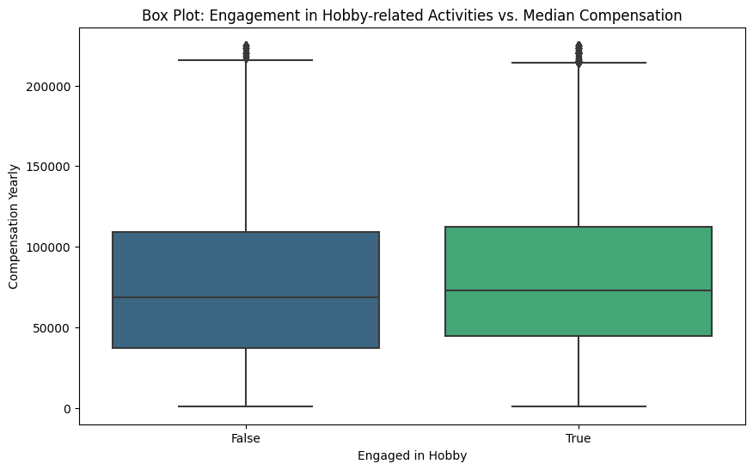
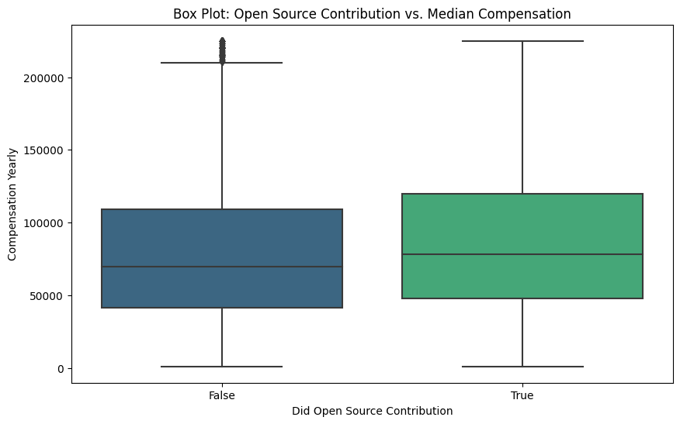
Hobby & Open Source Contribution Vs Compensation
Exploring the impact of coding activities on compensation revealed a slight higher median compensation for individuals engaged in hobby-related coding activities and open-source contributions. This observation emphasizes the potential correlation between personal interests and earnings in the developer community.

Slide 17
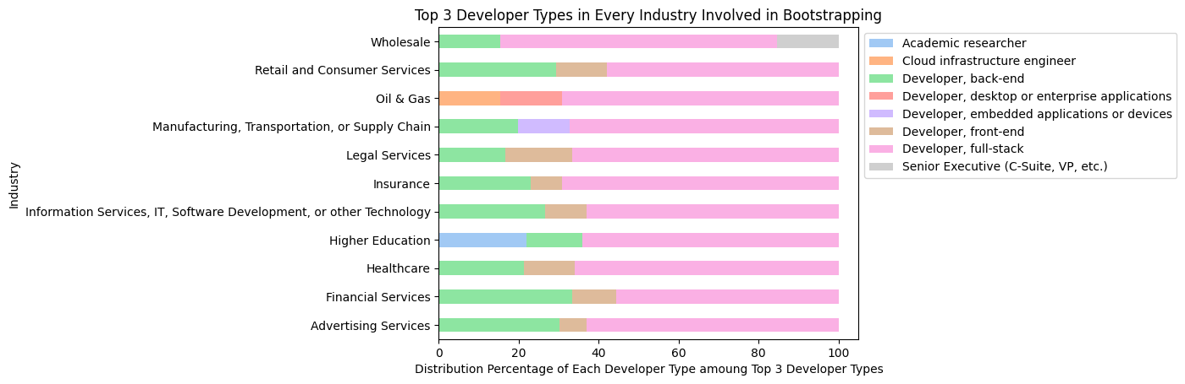
Entrepreneurial Aspirations
Focusing on developers involved in entrepreneurial activities, the analysis identified the top three developer types engaged in bootstrapping businesses across various industries. Notable findings include full stack, frontend, and backend developers being likely to venture into entrepreneurship across industries.

Slide 18
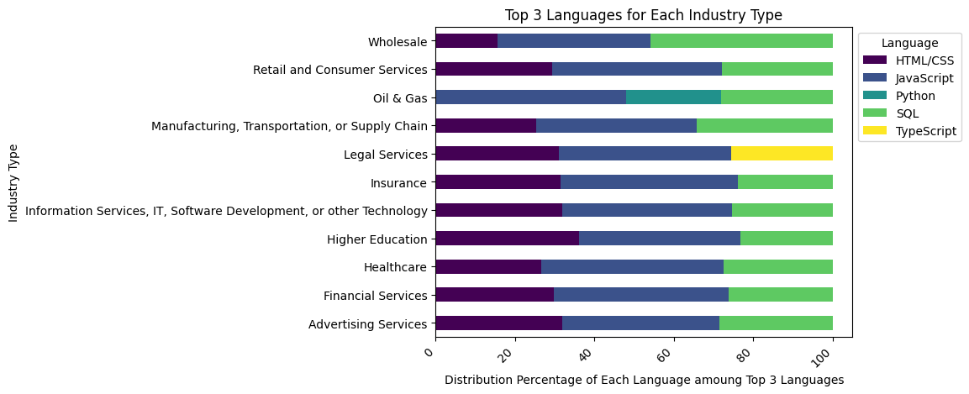
Freelancer Demographic
The pie chart exploring the distribution of freelancers across industries unveiled significant representation from the IT industry, financial services, and healthcare. This observation provides insights into the sectors where freelance developers are more common, contributing to a nuanced understanding of the freelance landscape. Observations highlighted HTML/CSS, JavaScript, and SQL as the top three languages used by freelancers across all industries. This implies a consistent demand for full-stack development skills in the freelance market.

Slide 19
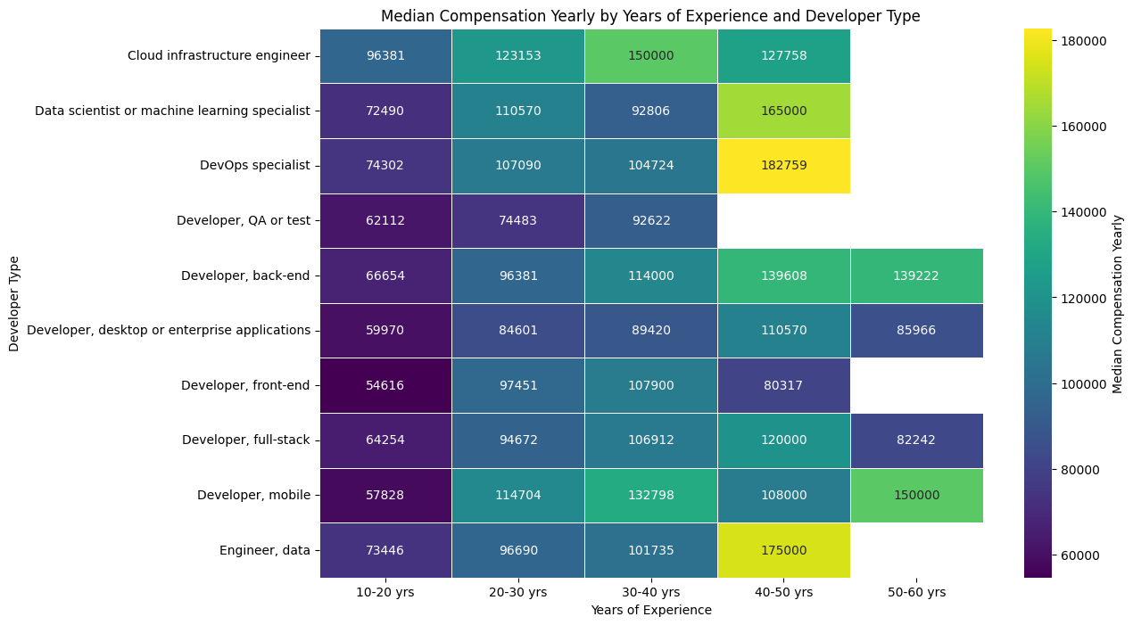
Compensation Dynamics Across Developer Type
The heatmap provided a visual narrative of the intricate relationship between developers' tenure, roles, and median compensation. Notably, Cloud Engineers, DevOps, and Machine Learning Engineers exhibited rapid increases in median income, offering valuable insights into compensation dynamics.

Slide 20
Hypothesis Testing

Slide 21
Hypothesis Testing
Statistical Tests
01
Hypothesis testing is a statistical method crucial for drawing inferences about population parameters based on sample data. It involves formulating a hypothesis about the population parameter, collecting and analyzing data, and drawing conclusions to determine the validity of the hypothesis.
Chi Square Test
Reveals whether two categorical variables are associated, highlighting independence or dependence.
03
Proportions Z Test
Compares the proportions of two groups and evaluates whether they significantly differ from each other.
02
Z Test
Checks if the mean of a population differs from a hypothesized value or compares the means of two populations.

Slide 22
Use Cases
Career Progression Difference
Developer Types & Coding Activities
H0: Individuals with Master's degrees have higher compensation than those with Bachelor's degrees.
H1: No difference exists in compensation between Master's and Bachelor's degree holders.
H0: Coding activities are independent of developer types.
H1: Different developer roles engage in significantly different types of coding tasks.
Education Levels & Bootstrapping Business
Full Time Vs Freelancers Earnings
H0: Relation between Education Levels & Bootstrapping Business.
H1: No Significant Relation between Education Levels & Bootstrapping Business.
H0: Yearly earnings are similar for Full-time and Freelancers developers.
H1: Full-time developers earn significantly more than Freelancers developers.
Impact of Coding & Opensource
Contribution on Compensation
Opensource Contributions in Developer Roles
H0: Open-source contribution is not associated with higher compensation.
H1: Developers who contribute to open-source projects earn higher salaries than non-contributors.
H0: The proportion of open-source contributors is consistent across different developer roles.
H1: The prevalence of open-source contribution varies significantly among specific developer types.

Slide 23
Statistical Tests
Career Progression Difference
Developer Types & Coding Activities
Test: One Tail Z Test
Compensation for individuals with Master's degrees is lower than those with Bachelor's degrees
Test: Chi Square Test
Significant Relation between Developer Type & Coding Activities
Education Levels & Bootstrapping Business
Test: Chi Square Test
Significant association between education levels & intention to start business
Full Time Vs Freelancers Earnings
Test: Z Test
No Significant difference between earnings of Full time developers and Freelancers
Impact of Coding & Opensource
Contribution on Compensation
Opensource Contributions in Developer Roles
Test: One Tail Z Test
Higher Compensation for Developers indulging in these coding activities
Test: Proportions Z Test
Significant difference in proportions for developers in full-stack and cloud infrastructure roles regarding open-source contributions.

Slide 24

Final Reflections & Future Work
Hobby-related coding strongly correlates with higher median compensation for developers.
Embracing coding as a hobby can lead to increased financial benefits for developers.
Freelancers, especially early in their careers, tend to experience higher incomes than full-time developers.
These findings have implications for employers, educators, and policymakers in talent management and policy development. Recognizing the impact of coding engagement can inform strategies for fostering more inclusive and dynamic software development environments.
Future research should explore nuanced relationships between coding activities, career paths, and financial outcomes.

Slide 25
THANK YOU

